Slide 1
Maslow's Hierarchy of Needs Theory
Prepared By:
University of Phoenix
Due Date:
Faculty Name

Slide 2
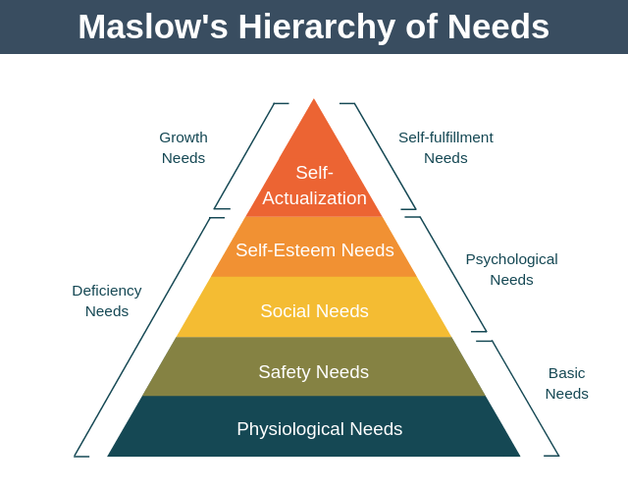
Introduction
  Abraham Maslow used the theory of hierarchy of needs to describe how human beings are motivated to satisfy five basic needs.
  Also, he believed that our behaviours are driven by various needs
  The needs are pursued in a hierarchical fashion
Notes:
According to Maslow, various basic needs predispose people to choose one behaviour over the other. The needs start from the bottom of the hierarchy all the way to the top. He also claimed that pursuit of higher level needs is contingent upon lower level needs being met (Boeree, 2006).

Slide 3
Physiological Needs
  What motivates people change through their working life
  It is difficult to motivate employees if their basic needs are not met
  For physiological needs to be met, employers need to reward their employees financially
  Workers start looking for other aspects to be included in their jobs once their physiological needs are met
Notes:
Beginning their career, people have fundamental basic physiological needs; the need for clothing, shelter, food, rent and bills, among other overheads. For these needs to be met, employers need to focus on paying and setting up systems so that workers can be rewarded financially. People get employed for them to be able to meet their basic needs. Maslow said that once employees feel like their basic needs are met or rather like they are earning through their jobs and they are taking account of their physiological needs, this need stops acting as a source of motivation and workers cast their glance up to the next level in the hierarchy (Boeree, 2006). They start looking for other aspects to be included in their jobs.

Slide 4
Safety Needs
Employees need assurity of job security, longevity, and permanency to their employment prospects (Boeree, 2006). After their physiological needs have been met, they start considering these factors:
  Health benefits
  Pension
  Safety in the working environment
Notes:
Employees need to feel safe and secure in their jobs. That could be in terms of health, safety of the working environment and it can also be through how they feel about the security of the job whether they are on a permanent or fixed contract, whether they have a pension that is going to see them through into retirement. To meet these needs, employers need to provide things like health benefits, pension programs, and ensure there are policies guaranteeing employee’s safety in the working environment. When these needs are met, Maslow argues that employees will still not be satisfied as they will glance further to the next level of the needs hierarchy.

Slide 5
Social Needs
Social needs may include things like:
    Team Working
    Collaboration
    For group ethos
    Being involved in a greater organization
    Seeing the working place as a place to socialize
Notes:
Once employees reach a certain stage in their careers they start looking for social needs. It’s these needs that take over as their primary motivator. They start looking for social opportunities through their job, team working, collaboration, for a group ethos and satisfaction that comes from working in a place they are allowed to socialize or even being involved in a greater organization. To meet this need, employers need to encourage team work, collaboration, formation of group ethos, as well as creating a conducive working environment for all their employees. Once employees get these things, Maslow said they definitely start looking at the penultimate stage of his hierarchy as a source of their motivation. He described this as people’s esteemed needs.

Slide 6
Esteem Needs
Employees want to feel like they are achieving something and are recognized for doing a good job (Rouse, 2004).
Organizations need to be conscious of these needs by:
    Praising their employees
    Creating opportunities for rewards for employee’s hard work through promotions, career progression
Notes:
After weaving esteem needs into their structures, employers need to understand that some employees will go up to the fourth level of Maslow’s hierarchy and when they do that it will be difficult to be motivated by social needs. They will start looking for things that will keep them more motivated towards the highest states of their career pathways. Therefore, to meet this need, employers need to consider making available more rewards, promotions, and career progressions for high performers. Also, they should focus more on helping those who feel that their efforts are not recognized for some reasons. For example, they can encourage them to attend more trainings and even offer career progression programs. This way, they would feel part of the organization and as a result will try their best to improve their performance.

Slide 7
Self-Actualization
People has the desire to reach their full potential in their career
Employees who reach the fourth level will always go further to looking for the fifth level as their source of motivation. This is because:
    They will never feel like they have really achieved their full potential
    They will always be looking for that extra challenge or goal
Notes:
Even after going up to the fourth level of the hierarchy, some employees will not be satisfied; they will continue to look for that extra challenge or something that will make them feel like they have maximized their career full potential. To help such employees, Employers need to offer promotion opportunities for those who has tried their best to be the best performers. For example, a sales person who has achieved several milestones over the last 20 years would hate to continue doing the same thing he has been and, therefore look for something challenging. Employers should identify such an employee and perhaps promote him, for example, to a Sales Manager or create an environment that helps the employee self-actualize what he really wants to do next in his career.

Slide 8
How to use Maslow Theory?
As an assessment tool, I would use the theory to evaluate personal needs so I can know what to do to achieve my long-term goals
Also, I would use the hierarchy as a guideline for developing a list of things I need to do to move up my career ladder
As an employer, I would use the theory in decision making especially when there is a difficult decision that has to be made such as staff reduction

Slide 9
Humanistic Perspective of Personality Development
If an individual reaches the highest level of need (self-actualization), then he/she has reached his full potential. Such persons are:
  Healthy and demonstrate their optimal functioning
  Has a great sense of awareness
  Maintain constant enjoyment in life
  They know how to problem-solve
Notes:
Fulfilment of each level of Maslow’s hierarchy of needs is critical to development of personality. Individuals who have reached the highest level tend to actively engaged in activities that bring about feelings of meaningfulness in their life. They not only know how to problem-solve, but also live a fulfilled life while they enjoy a great sense of self-awareness.

Slide 10
Conclusion
When one need is met people always desire something else. Employers need to understand that Maslow’s theory is always working in the background. It is something that ends when all needs are met and, therefore, should be viewed as an ongoing obligation.
Also, when assessing different ways to motivate employees, employers need to know that employees will always evaluate how well your organization’s objectives align with their needs. If there are strategies that seek to take away any of their core needs, such a strategy will be deemed as undesired and they will resist it.

Slide 11
References
Boeree, C. G. (2006). Abraham Maslow: 1908-1970. Personality theories, 11.
Rouse, K. A. G. (2004). Beyond Maslow's Hierarchy of Needs: What Do People Strive For?. Performance Improvement, 43(10), 27.

